Slide 1
Consultancy Project
Data (24/March/2025)
Master Academic Year (2024/2025)
TEAM: Roberto Vanzetta, Helena Borges Daré, Ignacio Kreis, Jacopo Abete, Jasper von Pachelbel

Slide 2



Reactivation of Inactive Customers can help leverage Economic Potential
OUR CUSTOMER & CHALLENGE
EXPECTED OUTCOME
The customer, a leading European company in manufacturing and sales of tools and for the building a crafting sector
Significant proportion of customers are inactive, with no purchases in the past two years
Inactive customers are unrealized economic potential for the company
Development of a reactivation prediction model which identifies customers with the highest potential of return
Providing the company with a starting point to take targeted actions for reactivation and to maximise conversion
CRM reactivation

Slide 3


CRM Reactivation
CRM = Customer Relationship Management
includes all measures to build, maintain and reactivate customer relationships.
CRM Reactivation
to retarget customers which did not purchase since 2 years.
based on data analysis -> to select the customers with the highest probability of return and the highest economic potential.

Slide 4


Two datasets consisting of >2 million entries provide the basis for analysis
TOOL_SALES (Sales Data 2017 – 2021)
Purchase History of customers
Allows Identification of purchasing behaviour patterns
TOOL_CLIENT (Customer Database)
Client Information
Enables Customer Segmentation

Slide 5
Our Analytical Strategy follows 5 Steps
1
Data Understanding
5
Business Insights
Understanding of columns
Analysis and handling of missing values
Translation of findings into valuable business strategies
3
Feature Selection
2
Data Cleansing & Exploration
4
Train Models
Identification of patterns for active/inactive customers
Cleansing of unnecessary data
Metric Building

Slide 6

Understanding Customer Purchase Behavior
NEW FEATURES
KEY INSIGHTS
client_id | sales_id | n_purchases | sales_net | time_diff
9306 | 9306_201709 | 2 | 1579.03 | NaN
9306 | 9306_201709 | 2 | 1579.03 | NaN
9306 | 9306_201709 | 2 | 1579.03 | NaN
9306 | 9306_202010 | 2 | 1341.14 | 1126.0
8321 | 8321_201804 | 7 | 20.02 | NaN
8321 | 8321_201805 | 7 | 5.96 | 30.0
By analyzing past transactions (n_purchase), we can identify the likelihood of returning customers and tailor retention strategies accordingly.
High-value customers might be more receptive to personalized offers to encourage reactivation.
By tracking the time gap between sales (time_diff), we can segment customers based on their purchasing behavior.

Slide 7
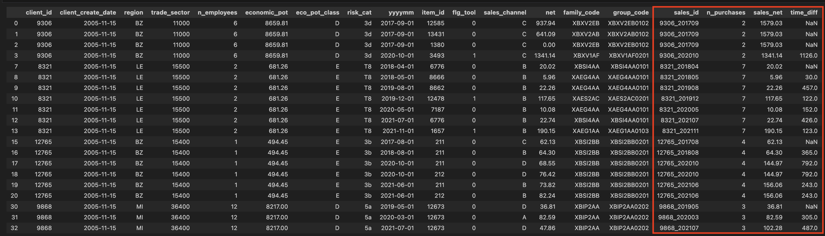
Original Dataset with new features
DATASET ANALYSIS

Slide 8

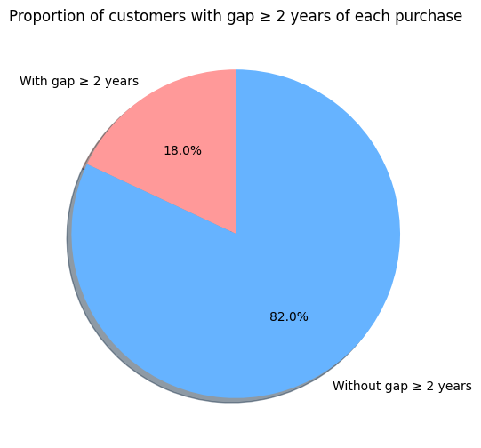
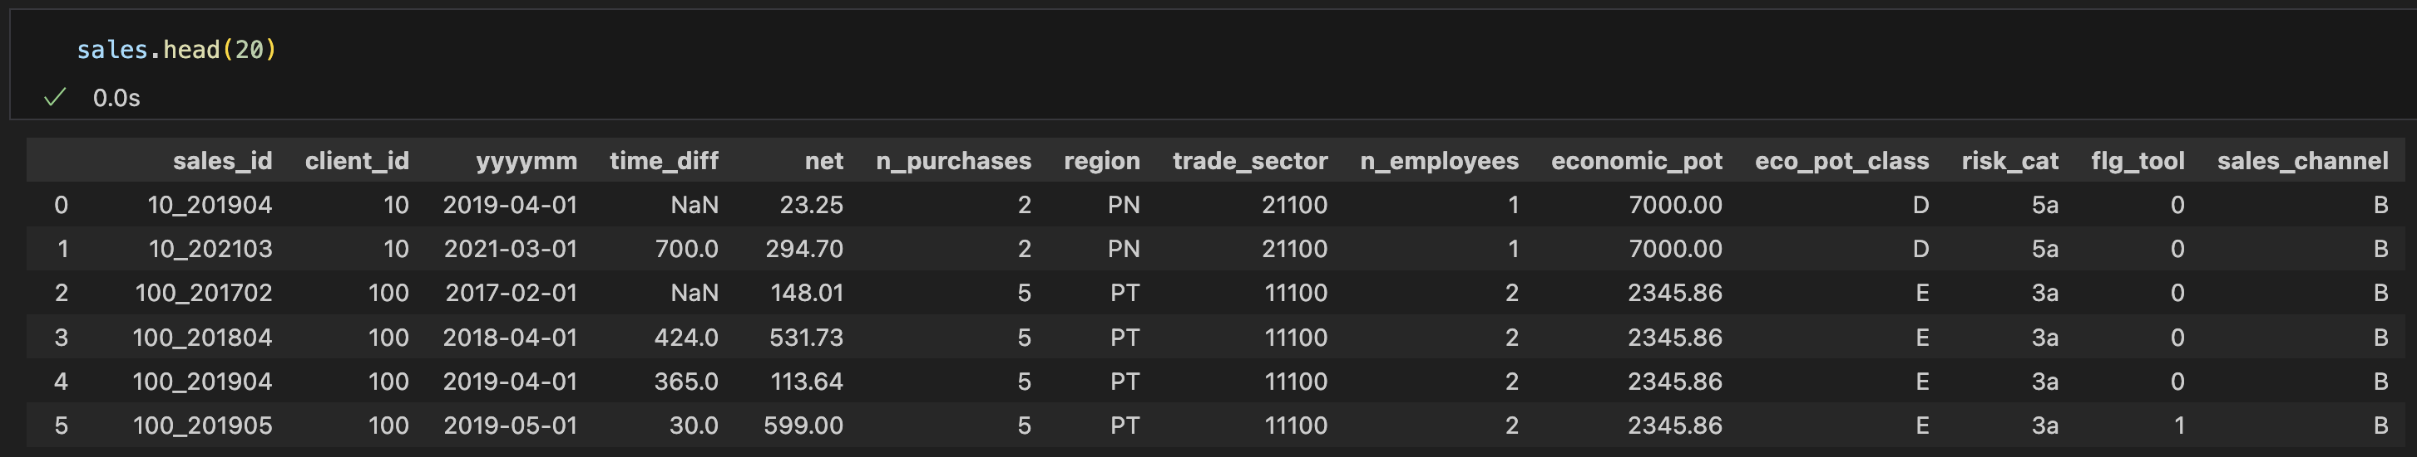
Enriching Sales Data for Actionable Insights
NEW FEATURES
KEY INSIGHTS
Our objective is to analyse historical sales data and identify patterns in customer purchases, particularly for customers who have been inactive for 2+ years.
Consolidation of dataset by merging transaction-level details with customer attributes
Predictive analytics using enriched data can improve forecasting of future sales performance
Risk-adjusted pricing strategies can be implemented for customers with lower churn probability (18% of total customers have a time_diff > 2 years)
client_id | sales_id | n_purchases | sales_net | time_diff
9306 | 9306_201709 | 2 | 1579.03 | NaN
9306 | 9306_201709 | 2 | 1579.03 | NaN
9306 | 9306_201709 | 2 | 1579.03 | NaN
9306 | 9306_202010 | 2 | 1341.14 | 1126.0
8321 | 8321_201804 | 7 | 20.02 | NaN
8321 | 8321_201805 | 7 | 5.96 | 30.0
By analyzing past transactions (n_purchase), we can identify the likelihood of returning customers and tailor retention strategies accordingly
High-value customers might be more receptive to personalized offers to encourage reactivation.
By tracking the time gap between sales (time_diff), we can segment customers based on their purchasing behavior.

Slide 9
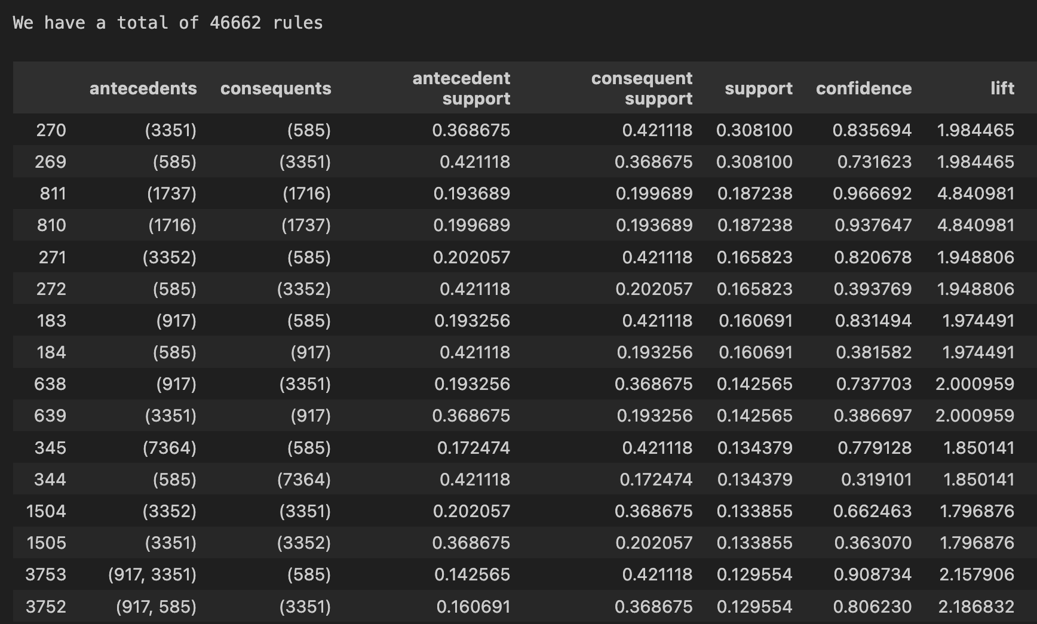
Using Association Rules¹ over 46k Purchasing Patterns were identified
DATASET ANALYSIS
KEY INSIGHTS
Strong Product Correlation between product x and product y
Common Rules (High Support) can be applied to a large part of customer base.
¹Method Used: Association Rules (Apriori Algorithm)
Notes:
Method Used: Association Rules (Apriori Algorithm)
We used a technique that’s often applied in retail: “People who buy this, also tend to buy that.”
Step-by-Step:
Grouped purchases per client.
Transformed that into a table of YES/NO (One-Hot Encoding)
Ran the Apriori Algorithm
Created rules like: "If a client buys item A and B, there’s a 90% chance they’ll also buy item C“
4. Sorted Rules by Strength
We focused on rules that are common and highly confident (they're true most of the time).

Slide 10

A Strong Purchasing Correlation was found for Items 3351 and 585
ITEMS 3351 & 585
RULE 1
A purchase of item 3351 also leads to a purchase of 585 :
83% Confidence
31% Support (percentage of customers the rule is true for)
1.98 Lift: the combination of items occurs almost twice as often as random combinations
Prediction of inactive customers’ likelihood to repurchase
¹Method Used: Association Rules (Apriori Algorithm)
Notes:
Strong product relationships — e.g., customers who bought product X are very likely to buy product Y.
Some rules are extremely confident (up to 96%) — meaning they’re very reliable.
Lift values > 1.5–4.8 show these aren't just random links — these are meaningful habits or needs.
Common rules (high support) mean we can apply these to a large part of the customer base.

Slide 11



Association Rules reveal Valuable Insights about Inactive Customers
If a customer previously purchased a part of a common purchasing patter, then we can predict what they are likely interested in next.
Customers share behaviour patterns with currently active customers.
Conclusion:
If a customer’s past behaviour matches a strong rule, indicating a future purchase, they are more likely to respond to targeted reactivation campaigns featuring related products.
Notes:
Technical Justification (Brief)
We chose Apriori with One-Hot Encoding for its explainability
The algorithm provides clear, interpretable rules
Each rule is backed by metrics like confidence and lift, which we use to measure predictive strength

Slide 12
Next Steps
1
2
Supervised approach
Classification
Unsupervised approach
Clustering
In addition to a predictive model, you can apply clustering to segment inactive customers into groups with similar characteristics
Goal: Create group of clusters based on purchase behaviors to understand the cycle of purchases for each client.
Ex: purchase every 3m, 6m, 1y
We split data in 2 groups (the ones who bought after 2 years/ who did not)
Now target column
Model Training using prepared data, build a machine learning model that outputs a probability of reactivation for an inactive customer.
Random Forest (handles non-linearity and works well with categorical variables)
Binary Logistic Regression (needs encoding, but can handle imbalanced data)
Neural Network
The goal is train a model that, given a customer’s historical features, predicts the chance they will “reactivate” (make a purchase after long inactivity).

Slide 13
THANK YOU FOR YOUR ATTENTION Q&A

Slide 14
